Slide 1
VLSI DESIGN
22EC2211A and 22EC2211R
Dr. Vijay Rao Kumbhare
Assistant Professor (ECE)
K L University, Hyderabad

Slide 2
Contents
Previous Lecture
Course introduction with Pre-requisite
Course handout and evaluation pattern
CH, Evaluation Plan, Formative Assessment
MOSFET BASICS:-
MODES; MOSFET as switch;
Symbols; VI Characteristics

Slide 3
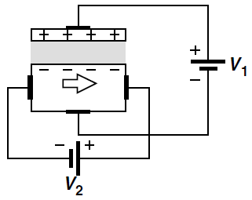
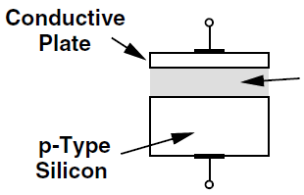
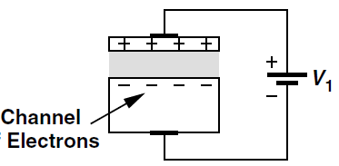
MOSFET Basics
Any voltage-controlled current source can provide signal amplification.
MOSFETs also behave as controlled sources but their characteristics are different from those of bipolar transistors.
A simple geometry consisting of a conductive (e.g., metal) plate, an insulator (“dielectric”), and a doped piece of silicon.
Such a structure operates as a capacitor
Figure 1 (a) Hypothetical semiconductor device, (b) operation as a capacitor, (c) current flow as a result of potential difference.

Slide 4
MOSFET Capacitor
When a negative voltage is applied to the gate
Vg < 0
Accumulation

Slide 5
MOSFET Capacitor
When a small positive voltage is applied to the gate
Vg > 0
Depletion
Depletion

Slide 6
MOSFET Capacitor
When a positive voltage above threshold voltage is applied to the gate
0 > Vg > V_{th}
Channel
Inversion

Slide 7
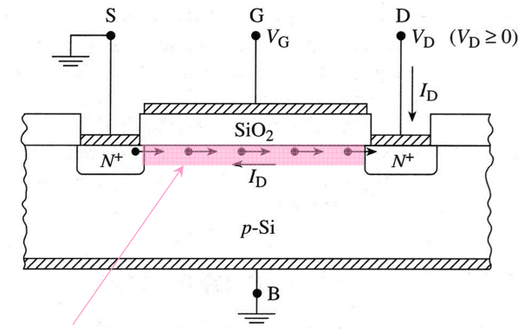
MOSFET
Metal Oxide Semiconductor Field Effect Transistor
Four terminal device: Source (S), Gate (G), Drain (D), and Body (B).
Flow of charge from “Source” to “Drain” is controlled by the “Gate” voltage.
Fig. 1 Basic Structure of MOSFET
Control by the Gate voltage is achieved by modulating the conductivity of the semiconductor region just below the gate. This region is known as the channel

Slide 8
Mode of Operation
Depletion mode and enhancement mode.
Depletion mode: The transistor requires the Gate-Source voltage (V_{GS}) to switch the device “OFF”. The depletion-mode MOSFET is equivalent to a “Normally Closed” switch.
Enhancement Type: The transistor requires a Gate-Source voltage (V_{GS}) to switch the device “ON”. The enhancement-mode MOSFET is equivalent to a “Normally Open” switch.
The formation of a channel between the source and drain can act as N-type or P-type MOSFET depending on the carriers doped in the channel region.

Slide 9
N-channel vs. P-channel
NMOS
PMOS
P+ poly-Si
N+ poly-Si
N+
N+
P+
P+
p-type Si
n-type Si
For current to flow, V_{GS} > V_{T}
to form n-type channel at surface
For current to flow, V_{GS} < V_{T}
to form p-type channel at surface
Enhancement mode: V_{T} > 0
Enhancement mode: V_{T} < 0
Depletion mode: V_{T} < 0
Transistor is ON when V_{G}=0V
Transistor is OFF during - V_{G}
Depletion mode: V_{T} > 0
Transistor is ON when -V_{G}
Transistor is OFF during +V_{G}
Note: V_{T} denotes the threshold voltage, some textbook uses the V_{t} notation.

Slide 10
Table 1 Types of MOSFET having N-type and P-type channel
Devices | Operating State | Applied Voltage as Gate terminal for
 |  | N- channel | P-channel
Depletion type | ON | – V_{G} Turns OFF | +V_{G} Turn OFF
Enhancement type | OFF | + V_{G} Turns ON | – V_{G} Turn ON
(a)
(b)
Fig. 2 Symbolic representation of n-channel/p-channel MOSFET under (a) depletion condition and (b) enhancement condition.

Slide 11
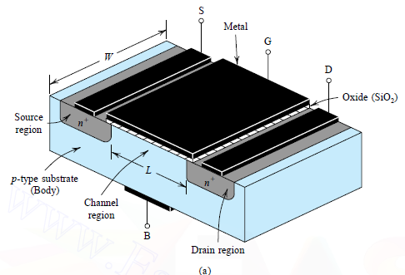
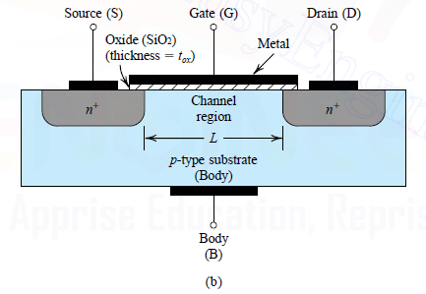
N-channel Enhancement type MOSFET
Perspective View
Cross-sectional View
Fig. 3 Physical structure of n-channel enhancement MOSFET (a) perspective view and (b) cross-sectional view.

Slide 12
N-channel Enhancement type MOSFET
The gate electrode is placed on top of a very thin insulating oxide (SiO₂) layer.
There are a pair of small n-type regions just under the drain and source electrodes.
If apply a +Ve voltage to gate (G), will push away the “holes” inside the p-type substrate and attracts the moveable electrons in the n-type regions under the source and drain electrodes.
Increasing the +Ve voltage of gate (G) pushes the p-type holes further away and enlarge the thickness of the created channel.
As a result, source to drain current increases-this is why this kind of transistor is called as enhancement mode device.
Fig. 3 Cross-sectional view of n-channel enhancement MOSFET

Slide 13
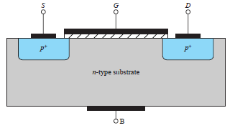
P-channel MOSFET
These behave in a similar way, but they pass the current when a –Ve gate voltage creates an effective p-type channel layer under the insulator.
All the voltage and current sign are reversed as compared to N-channel MOSFET.
The free charges that moves from end to end are positively charged (holes).
Fig. 4 Cross-sectional view of p-channel enhancement MOSFET
The PMOS and NMOS transistor are said to be complementary devices.

Slide 14
Operation of N-channel enhancement MOSFET
For an n-channel device with its source and substrate grounded (i. e., V_{S}=V_{B}=0 V).
For any value of V_{DS}: (Operation with zero gate voltage)
when V_{GS} <0 (accumulation), the source to drain path consists of two back to back diodes.
One of these diodes is always reverse biased regardless of the drain voltage polarity.
V_{DS} ≥ 0 V
when 0<V_{GS} <V_{T} (depletion), there is a deficit of electrons and holes making the channel highly resistive.
No Drain current can flow.
Fig. 5 n-channel enhancement MOSFET at zero gate voltage.

Slide 15
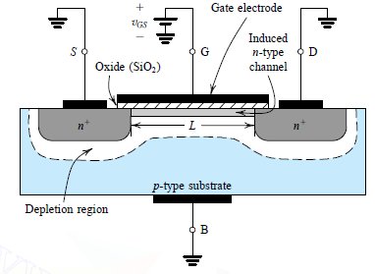
Consider now the Inversion case:
First, V_{DS} = 0:
when V_{GS} > V_{T} , an induced n- type region, an “inversion layer”, forms in the channel and “electrically connects” the source and drain
The channel is created by inverting the substrate surface from p-type to n type. Hence the induced channel is also called an inversion layer.
The value at which a sufficient number of mobile electrons accumulate in the channel region to form a conducting channel is called the threshold voltage (V_{T}).
V_{T} ranges from 0.3 to 1V.
Fig. 6 n-channel enhancement MOSFET at positive gate voltage.

Slide 16
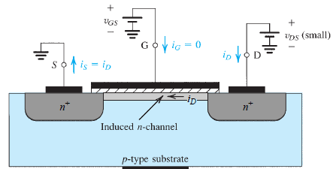
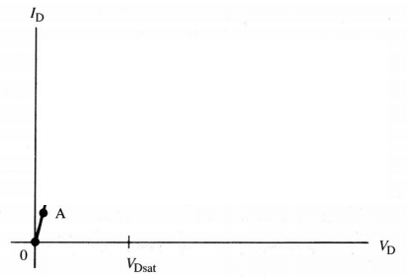
Inversion case, V_{GS} > V_{T} (continued): (Applying a small V_{DS})
When V_{DS} >0 , the induced n-type region allows current to flow between the source and drain.
The induced channel acts like a simple resistor. Thus, this current, I_{D}, depends linearly on the Drain voltage V_{D}. This mode of operation is called the linear or “triode”* region.
Fig. 8 Drain current (I_{D}) verses drain voltage (V_{D}) when in the linear or “triode”* region.
Fig. 7 n-channel enhancement MOSFET with V_{GS}>V_{T} and a small V_{DS} applied

Slide 17
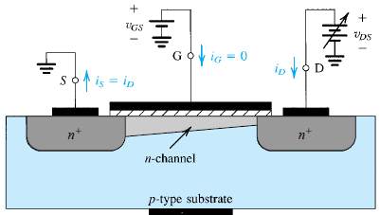
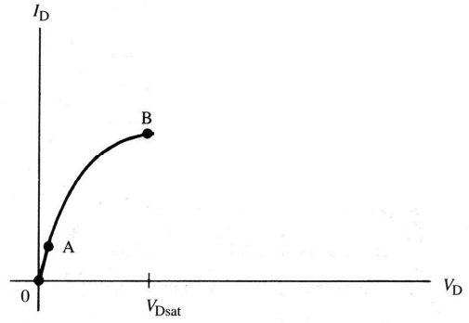
Inversion case, V_{GS} > V_{T} (continued):
When V_{DS} increases a few tenths of a volt (>0):
The depletion region near the drain widens (N+ drain is positively biased – i.e. reverse biased with respect to the substrate).
The electron concentration in the inversion layer near the drain decreases as they are “sucked out” by the drain voltage.
Channel conductance decreases resulting in a drop in the slope of the I_{D} – V_{D} curve.
Fig. 9 n-channel enhancement MOSFET with V_{GS}>V_{T} and increased V_{DS} .
Fig. 10 Drain current verses drain voltage for increasing V_{DS} (still in the “linear” or triode region).

Slide 18
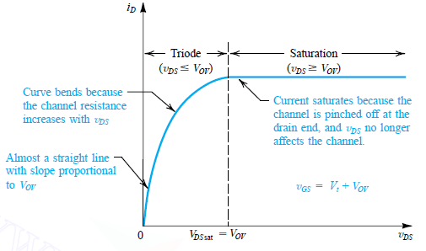
Inversion case, V_{GS} > V_{T} (continued):
The inversion layer eventually vanishes near the drain end of the channel. This is called “Pinch-Off” and results in a Flat I_{D}-V_{DS} curve.
Fig. 11 The drain current versus the drain-to source voltage for an enhancement type NMOS transistor operated with V_{GS}=V_{T}+V_{OV.}
Where V_{T} and V_{OV} denote threshold voltage and over drive voltage, respectively.
The drain-source voltage, V_{DS}, at which this occurs is called the saturation voltage, V_{sat} while the current is called the saturation current, I_{Dsat}.

Slide 19
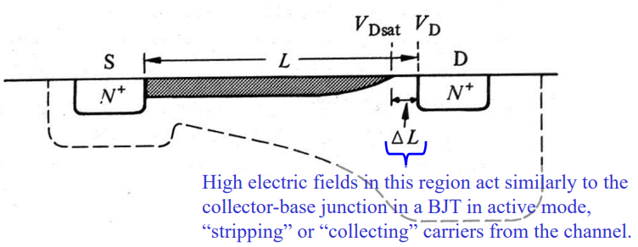
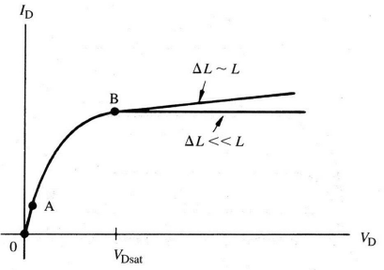
Inversion case, V_{GS} > V_{T} (continued):
For V_{DS}>V_{sat} the channel length, L, effectively changes by a value ΔL.
The region of the channel, ΔL is depleted and thus, is high resistivity.
If ΔL <<L, the voltage at the end of the channel will be constant (V_{sat} ) for all V_{DS}>V_{sat}.
I_{D} will be constant.
If ΔL ~L, the voltage dropped across the channel (V_{sat}) varies greatly with V_{DS} due to large modulations in the electric field across the pinched off region ( E=[V_{DS} -V_{sat}]/[ΔL]).
In this case, I_{D} increases slightly with V_{DS}.

Slide 20
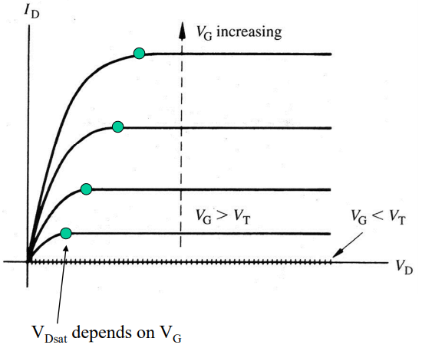
Finally,
I_{D}-V_{DS} curves for various V_{GS}:
Fig. 12 The Final drain current versus the drain-to source voltage for an enhancement type NMOS transistor.

Slide 21
The Depletion type MOSFET
Its structure is similar to that of the enhancement-type MOSFET with one important difference:
The depletion MOSFET has a physically implanted channel.
An n-channel depletion-type MOSFET has an n-type channel region connecting the n+ source and the n+ drain regions at the top of the p-type substrate.
If a voltage V_{DS} is applied between drain and source, a current I_{D} flows for V_{GS} = 0.
There is no need to induce a channel, unlike the case of the enhancement MOSFET.
The negative V_{GS} is said to deplete the channel of its charge carriers, and this mode of operation (negative V_{GS}) is called depletion mode.

Slide 22
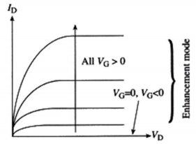
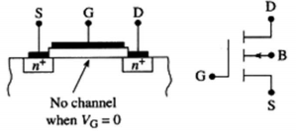
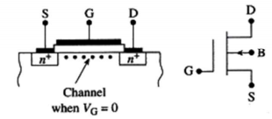
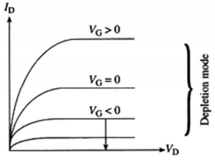
Enhancement Mode verses Depletion Mode MOSFET
N-channel MOSFET
Enhancement mode
Depletion mode
Structure
Symbol

Slide 23
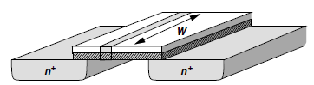
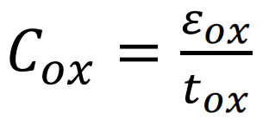
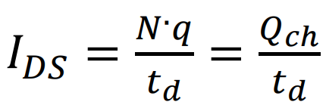
Derivation of I-V Characteristics
1. Channel Charge Density
From Q_{ch} = CV
C is the gate capacitance per unit length and V the voltage difference between the gate and the channel, then Q_{ch} is the desired charge density.
C = WC_{ox}
V = V_{GS} − V_{TH} because no mobile charge exists for V_{GS} < V_{TH}.
Q_{ch} = WCox(V_{GS} − V_{TH}).
Q_{ch} is expressed in coulomb/meter.
2. Drain Current at the linear, or triode, region.
Consider a bar of semiconductor having a uniform charge density (per unit length) equal to Q_{ch} and carrying a current I

Slide 24
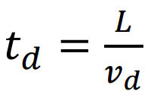
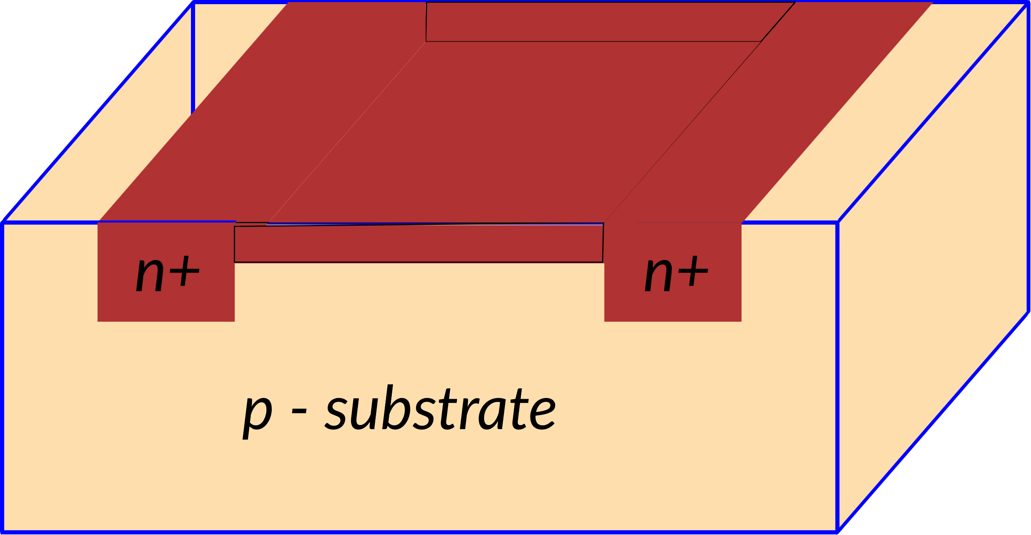
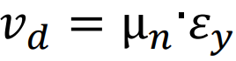
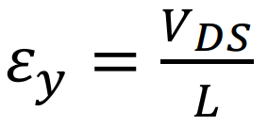
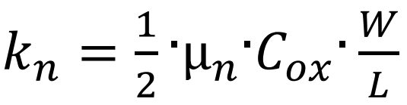
Derivation of I-V Characteristics
2. Drain Current at the linear, or triode, region. (as long as VDS kept in low level i.e VDS < VGS ‐ VTH)
Drift time, td, is directly proportional to the channel length L, and inversely proportional to the drift velocity of electrons, vd
Drift velocity, vd, is proportional to the horizontal electric field, εy, i.e.:
where µn is the electron mobility in the channel. The value of the horizontal electric field, εy, is, approximately, calculated as follows:
the following expression for IDS can be written as:
where kn is called conductivity factor for NMOS transistors. It is given by:

Slide 25
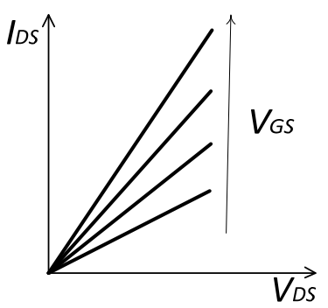
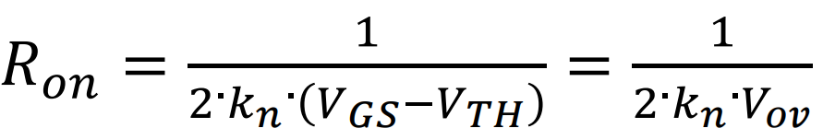
Derivation of I-V Characteristics
2. Drain Current at the linear, or triode, region. (as long as VDS kept in low level i.e VDS < VGS ‐ VTH)
(A)
The NMOS transistor operates in the linear, or triode, region, as long as VDS kept in low level i.e V_{DS} < V_{GS} ‐ V_{TH}
I_{DS} is proportional to V_{DS}.
Fig. 1 IDS ‐VDS curves of the NMOS transistor in linear region with VGS as parameter.
Practically, in linear region, the NMOS transistor acts like a variable resistance, Ron, whose value depends on Vov. Ron is calculated as follows:
(B)

Slide 26
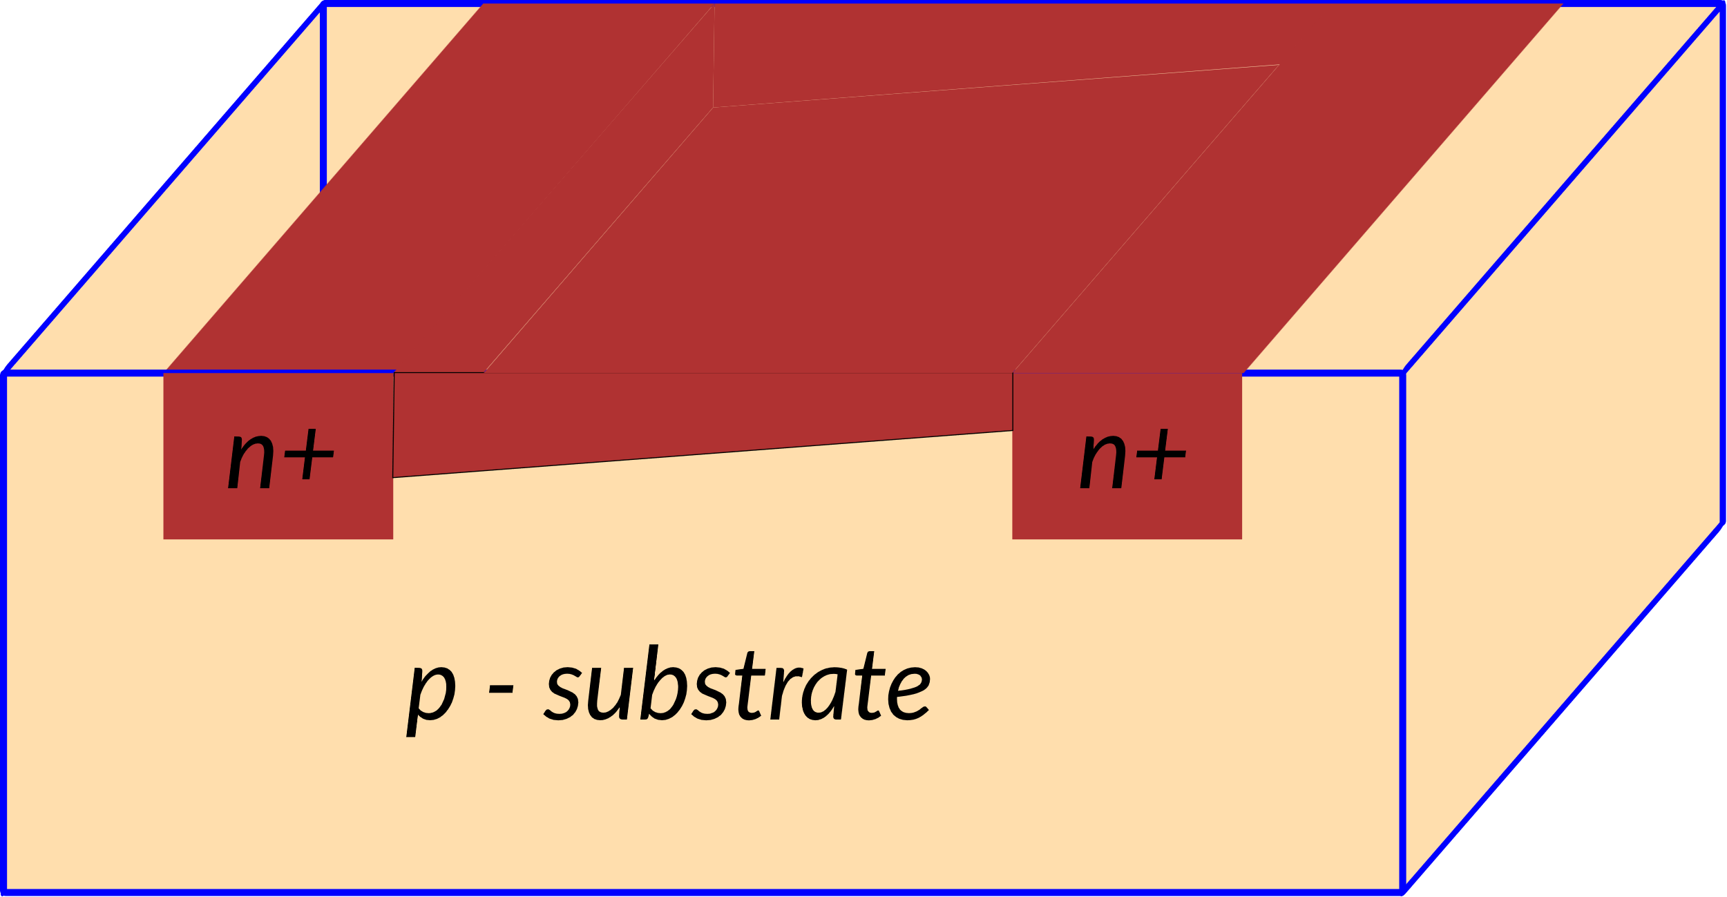
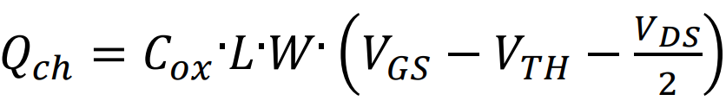
Derivation of I-V Characteristics
3. Drain Current at the linear, or triode, region. (As VDS is increased, the charge channel narrows at the drain end)
VDS modifies the voltage, and, the charge along the channel.
The voltage component due to VDS is maximum at the drain end, while it is zero at the Source end.
Suppose a linear distribution of the voltage component due to VDS along the channel, its average value can be approximately estimated to be VDS/2.
Then, a more accurate calculation of the channel charge can be obtained by adding VDS/2 in the charge expression
(C)
A more accurate calculation of the IDS current in linear region is also possible:
Drain Current at the linear, or triode, region.
(D)

Slide 27
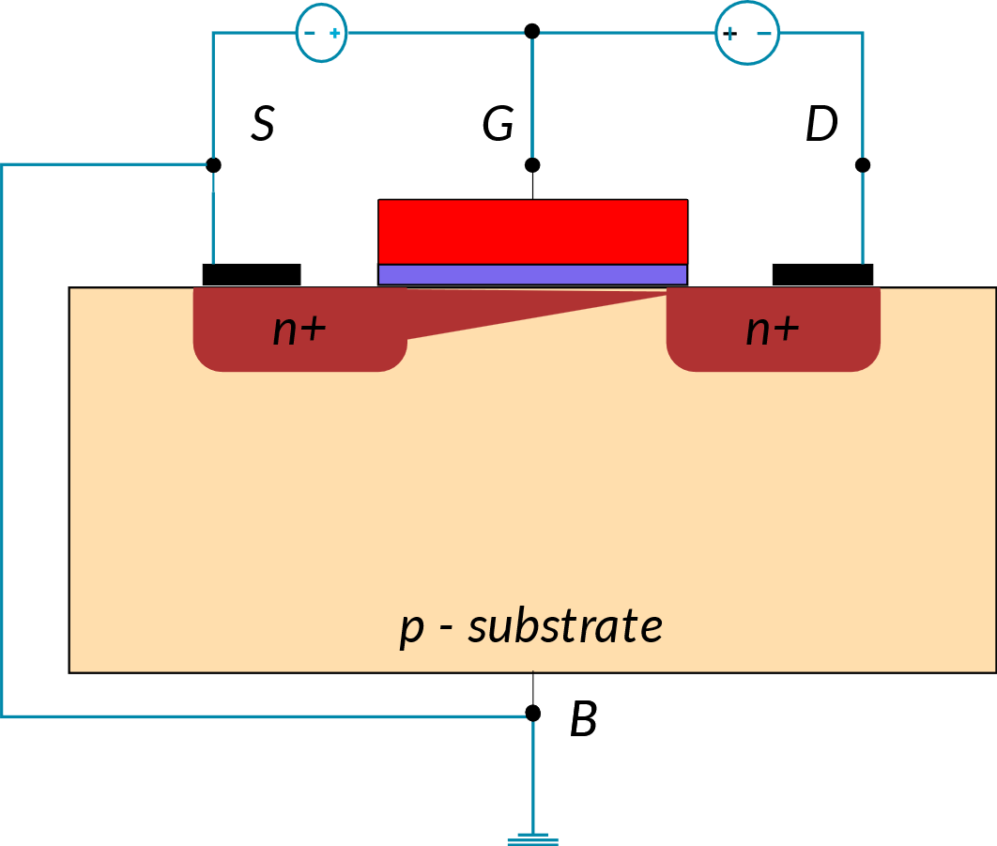
Derivation of I-V Characteristics
4. Drain Current at Saturation Region (As VDS approaches VGS‐VTH, )
As VDS approaches VGS‐VTH, the channel charge approaches zero at the Drain end.
When VDS compensates for the overdrive voltage VGS‐VTH, VGD results to be equal to the threshold voltage VTH
(E)
In this bias condition, no channel charge is available at the Drain end. The conducting channel pinches‐ off, disconnecting the Drain.
The VDS value that produces the channel pinch‐off is called saturation voltage (VDS,sat).
Substituting the VDS value in equation A, the expression of the IDS at the pinch‐off is obtained:
(F)
Therefore, when VDS increases, this depletion region enlarges, and the pinch‐off point moves toward the Source.
For your reference, Eq. A

Slide 28
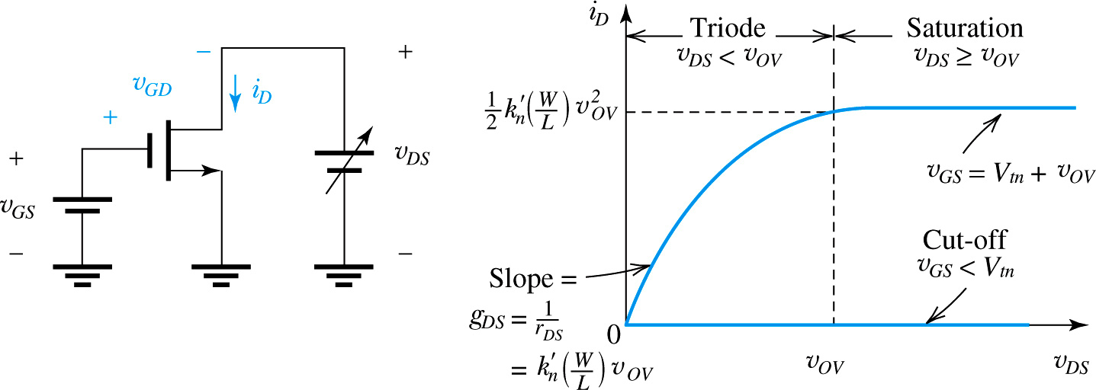
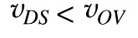
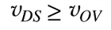
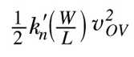
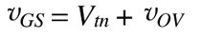
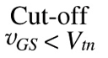
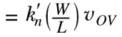
Non-linear effect and Current-voltage characteristics
The characteristics can be measured at dc or at low frequencies and thus are called static characteristics.
The dynamic effects that limit the operation of the MOSFET at high frequencies and high switching speeds.
where k’_{n} , g_{DS} , and r_{DS} are process transconductance parameter, channel conductance, and linear resistance, respectively.

Slide 29
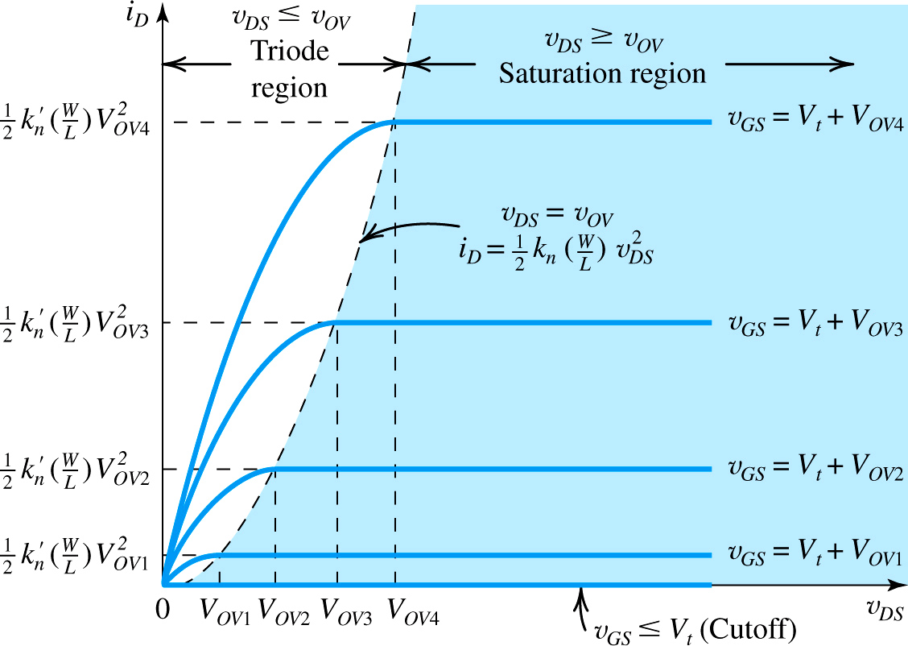
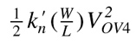
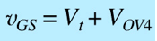
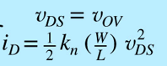
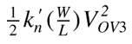
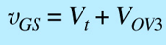
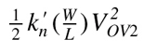
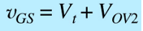
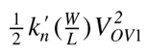
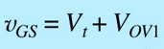
DC characteristics of MOSFET
Fig. 13 The drain current versus the drain-to source voltage for an enhancement type NMOS transistor.

Slide 30


Slide 31
Second Order Effects:
Following are the list of second order effects of MOSFET.
Channel length modulation
Velocity Saturation
Mobility Degradation
Threshold voltage – Body effect
Subthreshold region
Drain Punchthrough
Impact Ionization – Hot Electrons

Slide 32



Channel Length Modulation
The length of the channel changes with changing values of VDS.
As the value of VDS is increased, it causes the depletion region of the Drain junction to grow.
This reduces the length of the channel which impacts current. The model current equation must be modified to
In general, lambda is proportional to channel length.
The effects of channel length modulation become more pronounced for smaller feature sizes.
Thus, when a high impedance current source is required, longer channel transistors are used.

Slide 33


Channel Length Modulation
This phenomenon yields a larger drain current as V_{DS} increases because I_{D} ∝ 1/L₁

Slide 34
Velocity Saturation
Carrier velocity increases with increasing electric fields.
V= μE
At high electric fields (V_{DS}), carrier mobility degrades, eventually leading to a constant velocity.
However, once the critical lateral electric field is reached, the velocity of the carriers does not increase any further.
This is caused by an increased rate of collision and carrier scattering.
The current does not increase at the expected rate. Rather, the current increases very little.
Owing to their very short channels (e.g., 0.1 μm), modern MOS devices experience velocity saturation even with drain-source voltages as low as 1 V.

Slide 35
Mobility Degradation
With increasing VGS, vertical electric fields increase.
This increase causes a rise in the number of carrier collisions, which degrades carrier mobility.
The current flowing through the transistor is expected by the ideal models.
Mobility decreases with increasing temperature.

Slide 36

Body Effect
In MOSFETs, we have assumed that both the source and the substrate (also called the “bulk” or the “body”) are tied to ground.
However, this condition need not hold in all circuits.
If the source terminal rises to a positive voltage while the substrate is at zero, then the source-substrate junction remains reverse-biased and the device still operates properly.
An interesting phenomenon occurs as the source-substrate potential difference departs from zero:
The threshold voltage of the device changes.
In particular, as the source becomes more positive with respect to the substrate, V_{TH} increases. Called “body effect,”

Slide 37

MOS C-V Characteristics

Slide 38

MOS C-V Characteristics
There are three types of capacitances are involved that are
capacitance between gate electrode and substrate (C_{gb}),
capacitance between gate and drain terminals (C_{gd}) and
capacitance between gate and source terminals (C_{gs}).

Slide 39

MOS C-V Characteristics

Slide 40




MOS C-V Characteristics

Slide 41




MOS C-V Characteristics
Under Cutoff region
No channel Formation

Slide 42



MOS C-V Characteristics
Inversion Layer= Channel Formation

Slide 43







MOS C-V Characteristics
Saturation Region: VDS>Vds-Vth
Channel is in Pinch off condition
More depletion region occur

Slide 44

MOS C-V Characteristics

Slide 45

Basic Fabrication Steps

Slide 46
CMOS Fabrication Process [p-well method]
Assignment: CMOS Fabrication Process [N-well and Twin tube method]

Slide 47


Slide 48


Slide 49



Slide 50


Slide 51


Slide 52


Slide 53


Slide 54


Slide 55


Slide 56



Slide 57


Slide 58


Slide 59


Slide 60



Slide 61


Slide 62


Slide 63


Slide 64



Slide 65



Slide 66





Slide 67


Slide 68


Slide 69


Slide 70

Metallization Process

Slide 71


Slide 72


Slide 74
CMOS Fabrication Process [n-well method]

Slide 75
Fabrication of CMOS
CMOS can be obtained by integrating both the NMOS and PMOS transistors on the same chip substrate.
For integrating NMOS and PMOS devices on the same chip, special regions called as wells are required in which semiconductor type and substrate type are opposite to each other.
A P-well has to be created on a N-substrate or N-well has to be created on a P-substrate.
The fabrication of CMOS is described using the P-substrate, in which the NMOS transistor is fabricated on a P-type substrate and the PMOS transistor is fabricated in N-well.

Slide 76


Fabrication of CMOS
The fabrication of CMOS can be done by following steps given in the subsequent slides.
Step1: Substrate
Primarily, start the process with a P-substrate.
Step2: Oxidation
The oxidation process is done by using high-purity oxygen and hydrogen, which are exposed in an oxidation furnace approximately at 1000 degree centigrade.
SiO₂

Slide 77


Fabrication of CMOS
Step3: Photoresist
A light-sensitive polymer that softens whenever exposed to light is called as Photoresist layer. It is formed.
Photoresist
SiO₂
Step4: Masking
The photoresist is exposed to UV rays through the N-well mask
UV rays
N-well masking
Photoresist
SiO₂

Slide 78


Fabrication of CMOS
Step5: Photoresist removal
A part of the photoresist layer is removed by treating the wafer with the basic or acidic solution.
Photoresist
SiO₂
Step6: Removal of SiO2 using acid etching
The SiO2 oxidation layer is removed through the open area made by the removal of photoresist using hydrofluoric acid.
Photoresist
SiO₂

Slide 79


Fabrication of CMOS
Step7: Removal of photoresist
The entire photoresist layer is stripped off, as shown in the below figure.
SiO₂
Step8: Formation of the n-well
By using ion implantation or diffusion process n-well is formed.
SiO₂

Slide 80


Fabrication of CMOS
Step9: Removal of SiO₂
Using the hydrofluoric acid, the remaining SiO₂ is removed.
Step10: Deposition of polysilicon
Polysilicon is deposited on top of a very thin layer of gate oxide using Chemical Vapor Deposition (CVD) process.
Polysilicon
Thin gate oxide SiO₂
Thin oxide
Polysilicon

Slide 81


Fabrication of CMOS
Step11: Removing the layer barring a small area for the Gates
Except the two small regions required for forming the Gates of NMOS and PMOS, the remaining layer is stripped off.
Polysilicon
Thin gate oxide SiO₂
Step12: Oxidation process
Next, an oxidation layer is formed on this layer with two small regions for the formation of the gate terminals of NMOS and PMOS.
Thin oxide
Polysilicon

Slide 82


Fabrication of CMOS
Step13: Masking and N-diffusion
By using the masking process small gaps are made for the purpose of N-diffusion.
The n-type (n+) dopants are diffused or ion implanted, and the three n+ are formed for the formation of the terminals of NMOS.
Thin oxide
Polysilicon

Slide 83


Fabrication of CMOS
Step14: Oxide stripping
The remaining oxidation layer is stripped off
Step15: P-diffusion
Similar to the above n-diffusion process, the p-diffusion regions are diffused to form the terminals of the PMOS.
Thin oxide
Polysilicon

Slide 84


Fabrication of CMOS
Step16: Thick field oxide
A thick-field oxide is formed in all regions except the terminals of the PMOS and NMOS.
Step17: Metallization
Aluminum is sputtered on the whole wafer.
Aluminum
Aluminum
Thin oxide
Polysilicon

Slide 85


Fabrication of CMOS
Step18: Removal of excess metal
The excess metal is removed from the wafer layer.
Step19: Terminals
The terminals of the PMOS and NMOS are made from respective gaps.
Contacts
Aluminum
Thin oxide
Polysilicon

Slide 86
Fabrication of CMOS
Step20: Assigning the names of the terminals of the NMOS and PMOS
NMOS
PMOS
B
S
G
D
S
G
D
B
Fabrication of CMOS using P-well process
Among all the fabrication processes of the CMOS, N-well process is mostly used for the fabrication of the CMOS.
P-well process is almost similar to the N-well. But the only difference in p-well process is that it consists of a main N-substrate and, thus, P-wells itself acts as substrate for the N-devices.

Slide 87

Fabrication of BiCMOS
NMOS
PMOS
BJT-NPN
S
G
D
S
G
D
C
B
E
Oxide layer
n+ Emitter
Thick Oxide
n-well
P-Epitaxy
P-base
n-diffusion
n-well(collector)
p-diffusion
P-substrate
n+ buried layer
Thin oxide
Polysilicon

Slide 88
Stick Diagram

Slide 89
INTRODUCTION
Objectives:
To know MOS layers
To understand the stick diagrams
To learn design rules
To understand layout and symbolic diagrams
Outcome:
At the end of this, will be able draw the stick diagram, layout and symbolic diagram for simple MOS circuits

Slide 90






MOS LAYERS
Polysilicon
Transistor
Metal-Polysilicon
Diffusion
Depletion
Transistor
Metal
Metal-Diffusion
Contact
Polysilicon Pin
Butting
Implant
Diffusion Pin
Overglass
Metal Pin
Buried
Buried

Slide 91
STICK DIAGRAMS
Objectives:
To know what is meant by stick diagram.
To understand the capabilities and limitations of stick diagram.
To learn how to draw stick diagrams for a given MOS circuit.
Outcome:
At the end of this, will be able draw the stick diagram for simple MOS circuits

Slide 92
STICK DIAGRAMS
VLSI design aims to translate circuit concepts onto silicon.
A popular method of symbolic design ---- stick layout.
Stick diagrams convey layer information through color codes (or monochrome encoding).
Designer draw a free hand sketch of a Layout, using coloured lines to represent various process layers such as Diffusion ( p or n) , Metal and Poly-silicon where
Polysilicon layer crosses diffusion ------- Transistor are created. Metal wires join Diffusion or poly ------- contacts are formed.

Slide 93
STICK DIAGRAMS
Does show all components/vias.
Via is used to connect higher level metals from metal connection
It shows relative placement of components.
Goes one step closer to the layout
Helps plan the layout and routing
Does not show
Exact placement of components
Transistor sizes
Wire lengths, wire widths, tub boundaries
Any other low level details such as parasitics

Slide 94

STICK DIAGRAMS
Stick Diagrams – Notations

Slide 95

NMOS ENCODING
CIF
(Caltech Intermediate Format)
Notes:
Buried contacts: The buried contact is a method to make direct ohmic contact between the polysilicon gate material and the junctions,

Slide 96

CMOS ENCODING
Notes:
Buried contacts: The buried contact is a method to make direct ohmic contact between the polysilicon gate material and the junctions,

Slide 97


Stick Diagram- Some Rules
Rule 1:
When two or more ‘sticks’ of the same type cross or touch each other that represents electrical contact.
Rule 2:
When two or more “sticks of different type cross or touch each other there is no electrical contact.
(If electrical contact is needed we have to show the connection explicitly)
Notes:
Buried contacts: The buried contact is a method to make direct ohmic contact between the polysilicon gate material and the junctions,

Slide 98

Stick Diagram- Some Rules
Rule “3:
When a poly crosses diffusion it represents a transistor.
Note: If a contact is shown then it is not a transistor.
Notes:
Buried contacts: The buried contact is a method to make direct ohmic contact between the polysilicon gate material and the junctions,

Slide 99

Stick Diagram- Some Rules
Rule 4:
In CMOS a demarcation line is drawn to avoid touching of p-diff with n-diff.
All PMOS must lie on one side of the line and all NMOS will have to be on the other side.
Notes:
Buried contacts: The buried contact is a method to make direct ohmic contact between the polysilicon gate material and the junctions,

Slide 100



Example of Stick Diagram
Notes:
Buried contacts: The buried contact is a method to make direct ohmic contact between the polysilicon gate material and the junctions,

Slide 101

Example of Stick Diagram
Notes:
Buried contacts: The buried contact is a method to make direct ohmic contact between the polysilicon gate material and the junctions,

Slide 102

nMOS depletion load inverter
Notes:
Buried contacts: The buried contact is a method to make direct ohmic contact between the polysilicon gate material and the junctions,

Slide 103

nMOS Enhancement load inverter
Notes:
Buried contacts: The buried contact is a method to make direct ohmic contact between the polysilicon gate material and the junctions,

Slide 104


2 INPUT – CMOS NAND GATE
Notes:
Buried contacts: The buried contact is a method to make direct ohmic contact between the polysilicon gate material and the junctions,

Slide 105


2 INPUT – CMOS NOR GATE
Notes:
Buried contacts: The buried contact is a method to make direct ohmic contact between the polysilicon gate material and the junctions,

Slide 106

Examples of Stick Diagrams
NOR gate and NAND using NMOS Transistors
Notes:
Buried contacts: The buried contact is a method to make direct ohmic contact between the polysilicon gate material and the junctions,

Slide 107


Examples of Stick Diagrams
Notes:
Buried contacts: The buried contact is a method to make direct ohmic contact between the polysilicon gate material and the junctions,

Slide 108
Design Rules
Design rules are communication link b/w the designer specifying requirements and fabricator who materializes them.
First set of Design rules were introduced by Lambda based.
Stick diagram and mask layout is one and the same ,but in mask layout ,aspect ratio (L:W) & distance between any dimensions has to be shown.
Notes:
Buried contacts: The buried contact is a method to make direct ohmic contact between the polysilicon gate material and the junctions,

Slide 109


Slide 110


Slide 111


Slide 112


Slide 113


Slide 114


Slide 115


Slide 117



Slide 118




Slide 119







Slide 120




Slide 121




Slide 122






Slide 123





Slide 124



Slide 125


Slide 126


Slide 127


Slide 128

Design rules define ranges for features
Width: a min. wire widths to avoid breaks
Spacing: a min. spacing to avoid shorts
Overlap: a minimum overlaps with the another layers
Two types of Design Rules are applicable for industry and academic applications.
Most of the industry uses micron rules
Academic uses λ rules to design the layout.
Lambda (λ) is defined as the channel length divided by 2.
λ$=\frac{Channel Length (L)}{2}$

Slide 129

Design Rules
Minimum width of PolySi and diffusion line 2 λ
Minimum width of Metal line 3 λ as metal lines run over a more uneven surface than other conducting layers to ensure their continuity

Slide 130

Design Rules for spacing
PolySi – PolySi space 2λ
Metal1 – Metal1 space 3λ
Diffusion – Diffusion space 3λ
To avoid the possibility of their associated regions overlapping and conducting current
3λ

Slide 131

Design Rules for spacing
Diffusion – PolySi space λ
To prevent the lines overlapping to form unwanted capacitor
Metal lines can pass over both diffusion and polySi without electrical effect.
Where no separation is specified, metal lines can overlap or cross

Slide 132

It is recommended practice to leave λ between a metal edge and a polySi or diffusion line to which it is not electrically connected

Slide 133

Design Rules

Slide 134
Recall
– poly-poly spacing 2λ
– diff-diff spacing 3λ
– metal-metal spacing 3λ
– diff-poly spacing λ

Slide 135


Slide 136

Figure: Stick diagram and corresponding mask layout examples.

Slide 137

Figure: mask layout examples.

Slide 138

Figure: mask layout examples.

Slide 139

Figure: mask layout examples.

Slide 140
LAYOUTS
Layer Types
– p-substrate
– n-well
– n+
– p+
– Gate oxide
– Gate (polysilicon)
– Field Oxide
Insulated glass
Provide electrical isolation

Slide 141


Slide 142


Slide 143


Slide 144


Slide 145


Slide 146


Slide 147


Slide 148


Slide 149
Logic Effort
In general, the normalized delay of a gate (d) as a process independent unit has two components.
A fixed part called parasitic delay p due to the internal capacitance, when gate driving no load.
Other part proportional to the load on the output called the effort delay or stage effort f
Total delay is measured in units of τ, and is sum of these delays that can be expressed as
d = f + p
f is the effort delay or stage effort that depends on the complexity and fanout of the gate:
f = g×h
Where fanout or electrical effort h.
Where logical effort, g.

Slide 150
LOGIC EFFORT:
The complexity is represented by the logical effort, g.
Logical effort (g) of a gate is defined as the ratio of the input capacitance (C_{in,gate}) of the gate to the input capacitance of an inverter (C_{in,unit_inv}) that can deliver the same output current.
g = C_{in,gate} /C_{in,unit_inv}
An inverter is defined to have a logical effort of 1. More complex gates have greater logical efforts, indicating that they take longer to drive a given fanout.

Slide 151

LOGIC EFFORT:
A gate driving h identical copies of itself is said to have a fanout or electrical effort of h.
If the load does not contain identical copies of the gate, the electrical effort can be computed as
where Cout is the capacitance of the external load being driven and Cin is the input capacitance of the gate.
So, the total delay can further expressed as
d = g*h + p
Where, p = C_{intinsic,gate}/C_{intrinsic,inv}

Slide 152

Parasitic Delay
The parasitic delay of a gate is the delay of the gate when it drives zero load.
It can be estimated with RC delay models.
A crude method good for hand calculations is to count only diffusion capacitance on the output node.

Slide 153



EXAMPLE:
Estimate the logic effort g for the given circuits.

Slide 154


Slide 155









Slide 156


Slide 157



a circuit with a two way branch.
Consider a path from the primary input to one of the outputs.
The path logical effort G can be expressed as the products of the logical efforts of each stage along the path.
The path logical effort is G= g1x g2= (3/3)x(3/3)=1
The path electrical effort is
H = 90/5 = 18.
Thus, GH = 18.

Slide 158



The path effort F is the product of the stage efforts of each stage.
F = f1 f2 = (g1h1)(g2h2) = 1 × 6 × 1 × 6 = 36.
F = 2GH
The branching effort b is the ratio of the total capacitance seen by a stage to the capacitance on the path
=(15 + 15)/15 = 2
The path branching effort B is the product of the branching efforts between stages.

Slide 159

Logic effort for Hi-skew

Slide 160

Logic effort for Hi-skew
Reducing the logical effort on that critical transition to gu = 2.5/3 = 5/6.
The logical effort for the falling transition is estimated by comparing the inverter to a smaller unskewed inverter with equal pulldown current,
a logical effort of gd = 2.5/1.5 = 5/3.
Skewed gates are sometimes denoted with an H or an L on their symbol in a schematic.

Slide 161







Logic effort for Lo-skew

Slide 162
Inverter with different types of load
Resistive-Load Inverter:
Enhancement-load NMOS Inverter:
Depletion-load NMOS Inverter:

Slide 163

Different Load Inverter
The input voltage of inverter is equal to the gate to source voltage of nMOS transistor and output voltage of inverter is equal to drain to source voltage of nMOS transistor.
The source to substrate voltage of nMOS is also called driver for transistor which is grounded; so V_{SS} = 0.
The output node is connected with a lumped capacitance used for VTC.

Slide 164


Resistive Load type Inverter
Here, enhancement type nMOS acts as the driver transistor.
The load consists of a simple linear resistor R_{L}.
The power supply of the circuit is V_{DD} and the drain current I_{D} is equal to the load current I_{R}.
R_{L}
Circuit Operation
When the input of the driver transistor is less than threshold voltage V_{TH} (V_{in} < V_{TH}), driver transistor is in the cut – off region and does not conduct any current.
The voltage drop across the load resistor (R_{L}) is ZERO and output voltage is equal to the V_{DD}.
Now, when the input voltage increases further, driver transistor will start conducting the non-zero current and nMOS goes in saturation region.
Mathematically,

Slide 165

The chip area occupied by the resistive-load inverter circuit depends on two parameters, the (W/L) ratio of the driver transistor and the value of the resistor R_{L}.
The area of the driver transistor can be approximated by the gate area, (WxL).
VTC of the resistive load inverter, shown below, indicates the operating mode of driver transistor and voltage points.

Slide 166

Inverter with N type MOSFET Load
The main advantage of using MOSFET as load device is that the silicon area occupied by the transistor is smaller than the area occupied by the resistive load.
Here, MOSFET is active load and inverter with active load gives a better performance than the inverter with resistive load.
Enhancement Load NMOS
Load transistor can be operated either, in saturation region or in linear region, depending on the bias voltage applied to its gate terminal.
(a) Inverter circuit with saturated enhancement-type nMOS load. (b) Inverter with linear enhancement-type load.

Slide 167
Inverter with N type MOSFET Load
(a) Inverter circuit with saturated enhancement-type nMOS load. (b) Inverter with linear enhancement-type load.
It requires a single voltage supply and simple fabrication process and so V_{OH} is limited to the V_{DD} − V_{T}. (In Fig. a)
It always operates in linear region; so V_{OH} level is equal to V_{DD}. (In Fig. b)

Slide 168
Inverter with N type MOSFET Load
Linear load inverter has higher noise margin compared to the saturated enhancement inverter.
The disadvantage of linear enhancement inverter is, it requires two separate power supply and both the circuits suffer from high power dissipation.
Enhancement inverters are not used in any large-scale digital applications.

Slide 169

Depletion load Inverter
Most of the disadvantages of the enhancement-type load inverter can be avoided by using a depletion-type nMOS transistor as the load device.
The fabrication process for producing an inverter with an enhancement-type nMOS driver and a depletion-type nMOS load is slightly more complicated and requires additional processing steps, especially for the channel implant to adjust the threshold voltage of the load device.
The immediate advantages of implementing this circuit configuration are:
sharp VTC transition and better noise margins,
single power supply, and
smaller overall layout area

Slide 170

Extra: ALTERMTIVE FORMS OF PULL-UP
4. Complementary transistor pull-up (CMOS):
(a) No current flow either for logical 0 or for logical 1 inputs.
(b) Full logical 1 and 0 levels are presented at the output.
(c) For devices of similar dimensions the p-channel is slower than the n-channel device.

Slide 171

Inverter Static Characteristics (VTC)
Digital inverter quality is often measured using the Voltage Transfer Curve (VTC), which is a plot of input vs. output voltage.
Ideally, the voltage transfer curve (VTC) appears as an inverted step-function - this would indicate precise switching between on and off - but in real devices, a gradual transition region exists.
The VTC indicates that for low input voltage, the circuit outputs high voltage; for high input, the output tapers off towards 0 volts.
The slope of this transition region is a measure of quality - steep (close to -Infinity) slopes yield precise switching.
The tolerance to noise can be measured by comparing the minimum input to the maximum output for each region of operation (on / off).

Slide 172


Extra: ALTERMTIVE FORMS OF PULL-UP
Load resistance RL: This arrangement is not often used because of the large space requirements of resistors produced in a silicon substrate.
nMOS depletion mode transistor pull-up:
Dissipation is high ,since rail to rail current flows when Vin = logical 1.
Switching of output from 1 to 0 begins when Vin exceeds Vth of pulldown device.
When switching the output from 1 to 0, the pullup device is non-saturated initially and this presents lower resistance through which to charge capacitive loads .

Slide 173

Extra: ALTERMTIVE FORMS OF PULL-UP
3. nMOS enhancement mode pull-up .
(a) Dissipation is high since current flows when Vin = logical 1 (V_{GG} is returned to V_{DD}) .
(b) Vout can never reach V _{DD} (logical 1) if V _{GG} = V _{DD} as is normally the case.
(c) V_{GG} may be derived from a switching source, for example, one phase of a clock, so that dissipation can be greatly reduced.
(d) If V_{GG} is higher than V_{DD} then an extra supply rail is required.

Slide 175
Noise margin

Slide 176

Noise margin
It is a parameter related to the transfer characteristics.
It allows one to estimate the allowable noise voltage on the input of a gate so that the output will not be affected.
Noise margin (also called noise immunity) is specified in terms of two parameters - the low noise margin N_{L}, and the high noise margin N_{H} .
N_{L} is defined as the difference in magnitude between the maximum LOW input voltage recognized by the driven gate and the maximum LOW output voltage of the driving gate.
N_{L} =|V_{IL} - V_{OL}|
Similarly, the N_{H} is the difference in magnitude between the minimum HIGH output voltage of the driving gate and the minimum HIGH input voltage recognizable by the driven gate.
N_{H} =|V_{OH} - V_{IH}|

Slide 177

Inverter Dynamic Characteristics
The following are some formal definitions of temporal parameters of digital circuits. All percentages are of the steady state values.
Rise Time (t_{r}) : Time taken to rise from 10% to 90%.
Fall Time (t_{f}): Time taken to fall from 90% to 10%
Edge Rate (t_{rf}): (t_{r} + t_{f} )/2.
High-to-Low propagation delay (t_{pHL}): Time taken to fall from V_{OH} to 50%.
Low-to-High propagation delay (t_{pLH}): Time taken to rise from 50% to V_{OL}.
Propagation Delay (t_{p}): (t_{pHL} + t_{pLH})/2.
Contamination Delay (t_{cd}): Minimum time from the input crossing 50% to the output crossing 50%

Slide 178
Power Dissipation

Slide 179

Components of Power Dissipation
Unlike bipolar technologies, here a majority of power dissipation is static, the bulk of power dissipation in properly designed CMOS circuits is the dynamic charging and discharging of capacitances.
There are three main sources of power dissipation:
Static power dissipation (P_{S}) (due to leakage current when the circuit is idle)
Dynamic power dissipation (P_{D}) (when the circuit is switching)
Switching or Transient Power Dissipation
Short circuit power dissipation (P_{SC})
Thus the total power dissipation, P_{T}, is

Slide 180

Static Power Dissipation
CMOS logic is considered to have no static power dissipation.
Since the R_{OFF} of the two transistors is very large, the DC current driving a capacitive load is zero
This is not completely accurate since MOS transistors have leakage currents associated with the reverse-biased drain-to-substrate connections

Slide 181


Static Power Dissipation
When input = '0', the associated n-device is off and the p-device is on. The output voltage is V_{DD} or logic '1'.
When the input = '1', the associated n-device is on and the p-device turns off. The output voltage is '0' volts or V_{SS}.
It can be seen that one of the transistors is always off when the gate is in either of these logic states.
Since no current flows into the gate terminal, and there is no DC current path from V_{DD} to V_{SS}, the resultant quiescent (steady-state) current, and hence power , P_{s} is zero.
Fig. 1 CMOS inverter model for static power dissipation evaluation
However, there is some small static dissipation due to reverse bias leakage between diffusion regions and the substrate.

Slide 182
Static Power Dissipation
Static power consumption is the product of the device leakage current and the supply voltage.
Total static power consumption, P_{TS}, can be obtained as shown in equation 5.
The leakage current I_{leakage} (current into a device), along with the supply voltage V_{DD}, causes static power consumption in the CMOS devices.

Slide 183


Dynamic Power Dissipation
Dynamic power dissipation occurs when the MOS transistor switches to charge and discharge the output load capacitance for a particular node at operating frequency.
Fig. 3 Power dissipation due to charging/discharging of capacitor

Slide 184
Dynamic Power Dissipation
The dynamic dissipation can be modeled by assuming that the rise and fall time of the step input is much less than the repetition period.
The average dynamic power, P_{D}, dissipated during switching for a square-wave input, V_{in}, having a repetition frequency of f_{p} = 1/t_{p} , is given by
Where i_{n}= n-device transient current, i_{p} = p-device transient current
For a step input and with

Slide 185
Dynamic Power Dissipation
With f_{p}=1/t_{p}, the resulting in
Thus for a repetitive step input the average power that is dissipated is proportional to the energy required to charge and discharge the circuit capacitance.
The important factor to be noted here is that Eq (10) shows power to be proportional to switching frequency but independent of device parameters.
As can be seen from Eq (10), the power dissipated can be reduced by reducing either the clock frequency, f_{p} , or the load capacitance, C_{L} , or the rail voltage, V_{DD}, or the switching activity parameter.

Slide 186


Short Circuit Power Dissipation
The short-circuit energy dissipation results due to a direct path current flowing from the power supply to the ground during the switching of a static CMOS gate.
The switching power dissipation is due purely to the energy required to charge and discharge the load capacitance and independent of the rise and fall time of the driving waveform.
However, in a CMOS circuit if the rise and fall time have finite rise and fall time value, then for a particular time period during switching both nMOS and pMOS transistors will conduct simultaneously.
It provides a direct path between V_{DD} and the ground-rail resulting in short circuit power dissipation.
Fig. 4 Short Circuit current path
The current component that passes through both the nMOS and pMOS transistor during switching does not contribute to the charging of the capacitance in the circuit, and hence, it is called short circuit current.

Slide 187

Short Circuit Power Dissipation
The short-circuit power dissipation is given by
For the input waveform shown in Fig 5a, which depicts the short-circuit (Fig. 5b) in an unloaded inverter
assuming that V_{tn} = -V_{tp} and k_{n}=k_{p} and that the behavior is symmetrical around t₂.
(a)
With V_{in}(t)= (V_{DD}/t_{r}) t_{p} , t₁ =(V_{t}/V_{DD})t_{r} and t₂=t_{r}/2
Thus for an inverter without load, assuming that t_{r}=t_{f}=(t_{rf})
(b)
Fig. 5 (a) Input waveform and (b) short circuit current in unloaded inverter
where t_{p} is the period of the waveform.

Slide 188
Total Power Dissipation
As we saw above, there are three components to the power dissipation of a CMOS inverter:
Dynamic Power
Short Circuit Power
Static Power
Putting them all together, we get the total power consumption, P_{T,} of a CMOS logic gate

Slide 189
EXAMPLE: Consider 0.1 µm CMOS chip with a clock rate of 100 MHz, VDD = 2V and an average C_{load} = 3 fF per gate.
(a). What is the dynamic power dissipation per gate?
(b). If the chip incorporates 200,000 gates, what is the power dissipation for the chip? (alpha=0.2)

Slide 190



Slide 191
Numerical-1
Assume that the Electromigration rule is J_{AL} = 1.0 mA/μm and V_{DD} = 1.8 V.
Find the required power with a 500 MHz clock buffer that drives 5-pF on-chip capacitance.

Slide 192

Solution-1
The power dissipation of the clock buffer can be obtained using the expression given below

Slide 193

Numerical-2
As illustrated in Figure 1, suppose that a system with a switching capacitance of 500 pF, operating
at a frequency of 500 MHz, and a supply voltage of 1.8 V can be partitioned into two modules operating at the following conditions.
Module one operates at a frequency of 500 MHz and a supply voltage of 1.8 V. The switching capacitance is 300 pF.
Module two operates at a frequency of 200 MHz and a supply voltage of 1.2 V. The switching capacitance is 200 pF.
Calculate the power saving of the partitioned system.
Figure 1: An example of multiple supply voltages: (a) original system; (b) partitioned system.

Slide 194

Solution-2
The power dissipation of the original system is
The power dissipation of module one is found to be
The power dissipation of module two is calculated as follows

Slide 195
Solution-2
As a consequence, the power saving is equal to

Slide 196


Sources of Power Dissipations
POWER and ENERGY
Power is the instantaneous power in the device, while energy is the integration of power with time.
Figure 1.2 illustrates the difference between power energy.
Power is the height of the curve
Lower power could just be slower
Fig. 1.2 Power versus Energy
Notes:
For example, in Fig. 1.2, we can see that approach 1 takes less time but consumes more power than approach 2. But the energy consumed by the two, that is, the area under the curve for both the approaches is the same, and the battery life is primarily determined by this energy consumed.

Slide 197
Sources of Power Dissipations
Power dissipation is measured commonly in terms of two types of metrics:
Peak power: Peak power consumed by a particular device is the highest amount of power it can consume at any time.
The high value of peak power is generally related to failures like melting of some interconnections and power-line glitches.
Average power: Average power consumed by a device is the mean of the amount of power it consumes over a time period.
High values of average power lead to problems in packaging and cooling of VLSI chips.

Slide 198

Type of Power

Slide 199
Type of Power
Dynamic Power Dissipation
Dynamic power is the power consumed when the device is active, that is, when the signals of the design changing its value.
It is generally categorized into three types:
Switching Power
Short-Circuit Power
Glitching Power
Static Power Dissipation
Static power is the power consumed when the device is powered up but no signals are changing value.
In CMOS devices, the static power consumption is due to leakage mechanism.

Slide 200

Dynamic Power Dissipation
(1) Switching Power Dissipation
The first and primary source of dynamic power consumption is the Switching power dissipation occurs due the power required to charging and discharging of the output capacitance on a gate.
The energy per transition is given by
𝑬𝒏𝒆𝒓𝒈𝒚 Per 𝑻𝒓𝒂𝒏𝒔𝒊𝒕𝒊𝒐𝒏= 𝑪_{𝑳} × 𝑽²_{𝒅𝒅}
Where C_{L} is the load capacitance and V_{dd} is the supply voltage
Switching power is therefore expressed as:
𝑷𝒔𝒘𝒊𝒕𝒄𝒉 = (𝑬𝒏𝒆𝒓𝒈𝒚/ 𝑻𝒓𝒂𝒏𝒔𝒊𝒕𝒊𝒐𝒏) × 𝒇
= 𝑪_{𝑳} × 𝑽²_{𝒅𝒅} × 𝑷_{𝒕𝒓𝒂𝒏𝒔} × 𝒇_{𝒄𝒍𝒐𝒄𝒌}
Where f is the frequency of transitions, P_{trans} is the probability of an output transition and f_{clock} is the frequency of the system clock
Fig. 1.4 Dynamic (switching) power.
Notes:
In addition to the switching power dissipation for charging and discharging the load capacitance, switching power dissipation also occurs for charging and discharging of the internal node capacitance. Thus, total switching power dissipation is given by
𝐏𝐭𝐨𝐭𝐚𝐥𝐬𝐰𝐢𝐭𝐜𝐡 = 𝐂𝐋 × 𝐕𝐝𝐝 𝟐 × 𝐏𝐭𝐫𝐚𝐧𝐬 × 𝐟𝐜𝐥𝐨𝐜𝐤 + ∑ 𝛂𝐢 × 𝐂𝐢 × 𝐕𝐝𝐝 × (𝐕𝐝𝐝 − 𝐕𝐭𝐡) × 𝐟𝐜𝐥𝐨𝐜𝐤 (1.3)
Where αi and Ci are the transition probability and capacitance, respectively, for an internal node i.

Slide 201








Dynamic Power Dissipation
Switching Power Dissipation
Low-to-High Transition Equivalent Circuit
Energy Drawn From Power Supply
Fig. 1.4 Dynamic (switching) power.

Slide 202





Dynamic Power Dissipation
Switching Power Dissipation
Energy Stored on Load Capacitor
Low-to-High Transition Equivalent Circuit
Compared to E_{VDD}, we see that C_{L}V²$DD$/2 dissipated
Same amount dissipated when capacitor discharged
Independent of MOSFET resistance
Fig. 1.4 Dynamic (switching) power.

Slide 203

Dynamic Power Dissipation
(2) Short-Circuit Power Dissipation
In addition to the switching power, short-circuit power also contributes to the dynamic power.
Short-circuit currents occur when both the negative metal–oxide–semiconductor (NMOS) and positive metal–oxide–semiconductor (PMOS) transistors are ON
Let Vtn be the threshold voltage of the NMOS transistor and Vtp is the threshold voltage of the PMOS transistor.
Then, in the period when the voltage value is between Vtn and Vdd–Vtp, while the input is switching either from 1 to 0 or vice versa, both the PMOS and the NMOS transistors remain ON, and the short-circuit current follows from Vdd to ground (GND).
Fig. 1.5 Short-circuit current or crowbar current.

Slide 204

Dynamic Power Dissipation
The expression for short-circuit power is given by
Fig. 1.5 Short-circuit current or crowbar current.
Where tsc is the rise/fall time duration of the short-circuit current
Ipeak is the total internal switching current (short-circuit current plus the current to charge the internal capacitance)
μ is the mobility of the charge carrier
εox is the permittivity of the silicon dioxide
W is the width
L is the length
D is the thickness of the silicon dioxide.
Notes:
From the above equation it is evident that the short-circuit power dissipation depends on the supply voltage, rise/fall time of the input and the clock frequency apart from the physical parameters. So the short-circuit power can be kept low if the ramp (rise/fall) time of the input signal is short for each transition. Then the overall dynamic power is determined by the switching power.

Slide 205

Dynamic Power Dissipation
(2) Short-Circuit Power Dissipation (Detailed Derivation)
When there are finite rise and fall times at the input of CMOS logic gates, both pMOS and nMOS transistors are simultaneously ON for a certain duration, shorting the power supply line to ground.
This leads to current flow from supply to ground.
Fig. 1.5 Short-circuit current or crowbar current.

Slide 206
Dynamic Power Dissipation
(3) Glitching Power Dissipation
The third type of dynamic power dissipation is the glitching power which arises due to finite delay of the gates.
Glitches are temporary changes in the value of the output – unnecessary transitions
Glitches often occur when paths with unequal propagation delays converge at the same point in the circuit.
Glitches occur because the input signals to a particular logic block arrive at different times, causing a number of intermediate transitions to occur before the output of the logic block stabilizes.
These additional transitions result in power dissipation, which is categorized as the glitching power.

Slide 207
Impact of Technology Scaling

Slide 208

Technology Evolution
Today’s complex VLSI chips
The number of transistors has exceeded 120 million
Die area is typically about 1cm²
Moore’s low (Gordon Moore, one of the cofounders of the Intel Corporation)
The number of transistors on a chip would double about every 18 months
Design team and design hierarchy are needed to realize a complex chip

Slide 209

Why more transistors per IC?
Smaller transistors
Larger dice
Why faster computers?
Smaller, faster transistors
Better microarchitecture
Fewer gate delays per cycle

Slide 210
MOS Scaling
Reduction in size of an MOS chip by reducing the dimensions of MOSFETs and interconnects.
Reduction is symmetric and preserves geometric ratios which are important to the functioning of the chip. Ideally, allows design reuse.
Assume that S is the scaling factor. Then a transistor with original dimensions of L and W becomes a transistor with dimensions L/S and W/S.

Slide 211









Two major forms of scaling
Full scaling (constant-field scaling) – All dimensions are scaled by S and the supply voltage and other voltages are so scaled.
Constant-voltage scaling – The voltages are not scaled and, in some cases, dimensions associated with voltage are not scaled.
Drain
W ‘=W/S
Fig. 1 Scaling of device by factor of S

Slide 212

Constant Field Scaling
Proposed by Dennard in 1974
Also known as constant field scaling or Full scaling.
Voltage and MOSFET dimensions are scaled by the same factor S>1, so that the electric fields remains unchanged.

Slide 213
Constant Voltage Scaling
More preferred
All dimensions are scaled down except power supply and terminal voltages.
Increase in drain current density and power density by a factor of S³ adversely effecting device reliability.
That causes problems like
Electromigration
Hot Carrier Degradation
Gate Oxide Breakdown
Electrical Over-stress

Slide 214
Quantity | Sensitivity | Constant Field | Constant Voltage
Scaling Parameters
Length | L | 1/S | 1/S
Width | W | 1/S | 1/S
Gate Oxide Thickness | t_{ox} | 1/S | 1/S
Supply Voltage | V_{dd} | 1/S | 1
Threshold Voltage | V_{T0} | 1/S | 1
Doping Density | N_{A}, N_{D} | S | S²
Device Characteristics
Area (A) | WL | 1/S² | 1/S²
β | W/Lt_{ox} | S | S
D-S Current (I_{DS}) | β(V_{dd} - v_{T})² | 1/S | S
Gate Capacitance (C_{g}) | WL/t_{ox} | 1/S | 1/S
Transistor On-Resistance (R_{tr}) | V_{dd}/I_{DS} | 1 | 1/S
Intrinsic Gate Delay (τ) | R_{tr}C_{g} | 1/S | 1/S²
Clock Frequency | f=1/τ | S | S²
Power Dissipation (P) | I_{DS}V_{dd} | 1/S² | S
Power Dissipation Density (P/A) | P/A | 1 | S³

Slide 215
Observations of scaling
Constant field scaling:
Gate capacitance per micron is nearly independent of process
Gates get faster by a factor of S.
Dynamic power goes down with scaling.
Constant voltage scaling:
Gates get faster by a factor of S².
Power density increased by a factor of S³.
Current density goes up with scaling.

Slide 216

Thank you
..
Dr. Shyama Prasad Mukherjee International Institute of Information Technology, Naya Raipur

Slide 217

Impact of Constant-Field Scaling
(1)
(2)
(3)

Slide 218

Impact of Constant-Field Scaling
(4)
(5)
(6)

Slide 219


Impact of Constant-Voltage Scaling
(a) Scaling of gate oxide capacitance per unit area:
(7)
Here, the gate capacitance per unit area is increased by a factor of S.
(b) Scaling of transconductance:
(8)
Here, the transconductance is increased by a factor of S.
(c) Scaling of linear mode drain current:
(9)
Here, the linear mode drain current is increased by a factor of S.

Slide 220


Impact of Constant-Voltage Scaling
(d) Scaling of Saturation mode drain current:
(10)
Here, the saturation mode drain current is increased by a factor of S.
(e) Scaling of power dissipation and power density:
(11)
and
Here, the power dissipation and power density are increased by a factor of S and S³, respectively.

Slide 221
Thank you
..

